Slide 1
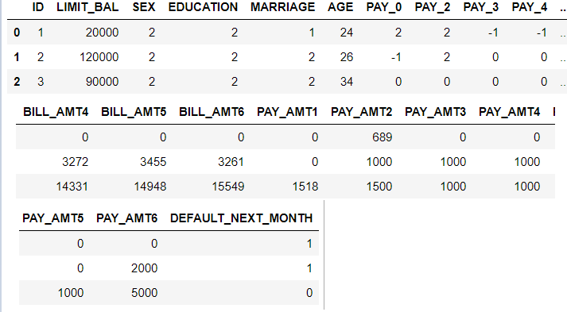

1. Download, explore, and prepare UCI credit card default data
y: prediction target.
X: all other input variables in the credit card default data except 'ID'.
Assign modeling roles

Slide 2
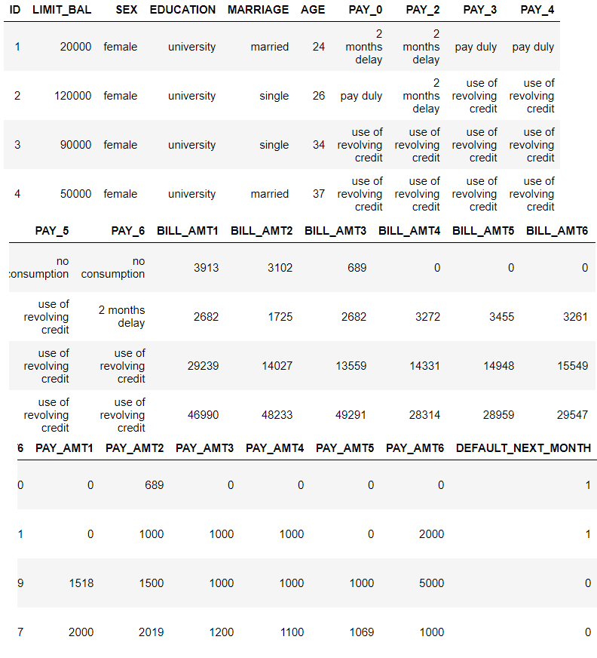
Parse: Helper function for recoding values
character can be used directly in h2o decision tree models
recode_cc_data(frame)
Pandas DataFrame
H2OFrame

Slide 3
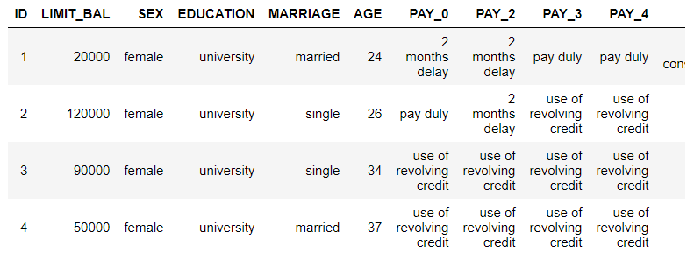
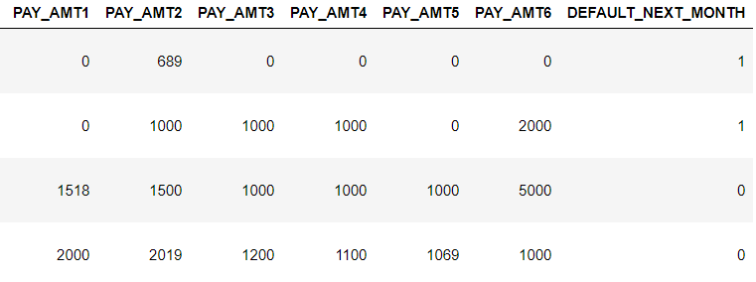
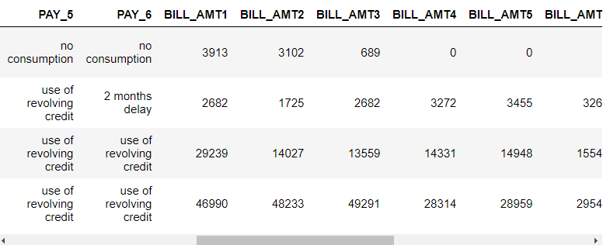
Target Processing:
Ensure target is handled as a categorical variable

Slide 4

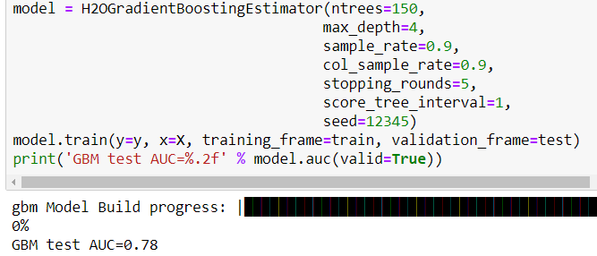
2. Train an H2O GBM Classifier:
Split into training data & test data
Train h2o GBM classifier
identify the best parameters for a given modeling task using the H2OGridSearch class.

Slide 5



3. LIME: Generate descriptions for a local region with a perturbed sample.
Display the most risky customer

Slide 6
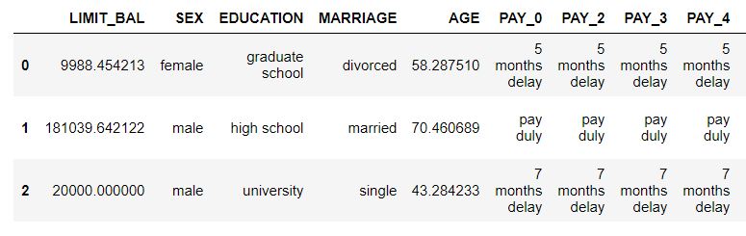
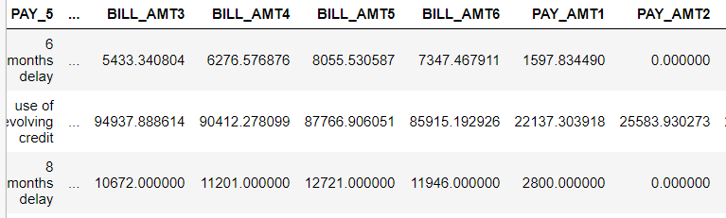
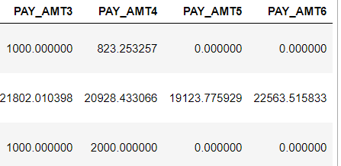
draws categorical values at random from the variable values in the test set.

Slide 7



draws numeric values from normal distributions centered around the customer of interest
Scaling & one-hot encoding for calculating Euclidian
distance
row containing the riskiest customer is encoded and standardized.

Slide 8
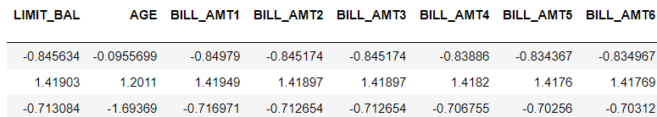
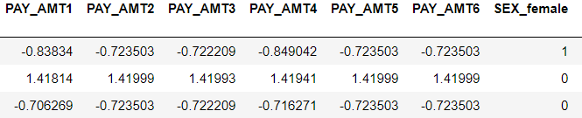
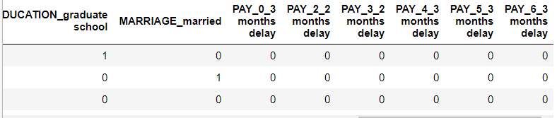
the simulated sample is encoded and standardized.

Slide 9

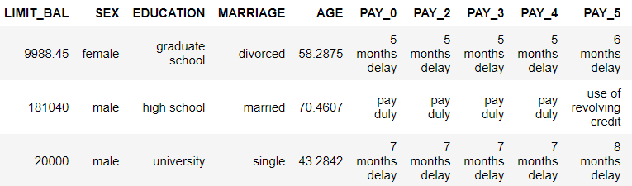
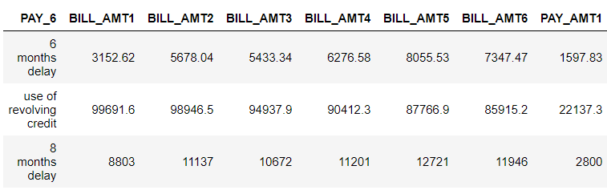
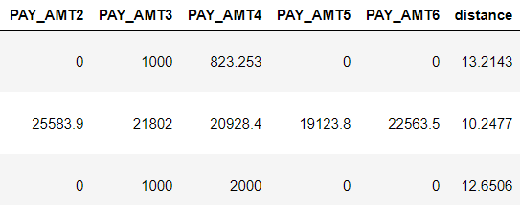
Generalized term for the Euclidean norm is the L2 norm/
Distance.
Bind distance weights onto perturbed sample

Slide 10
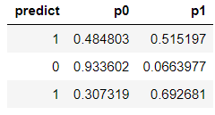
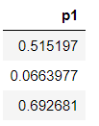
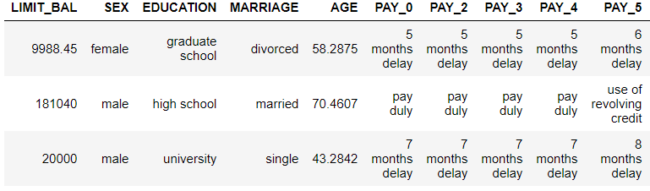
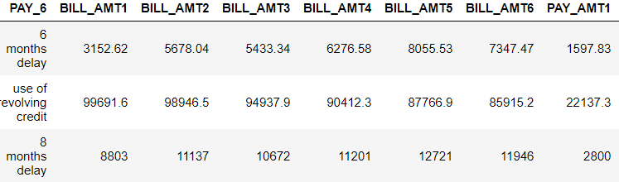
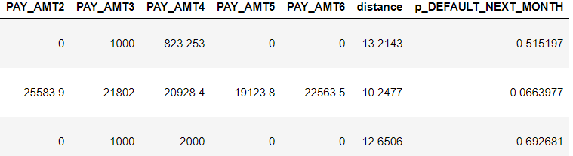
Bind model predictions onto perturbed sample
H2OGradientBoostingEstimator

Slide 11
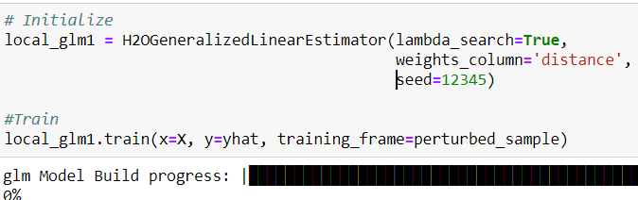
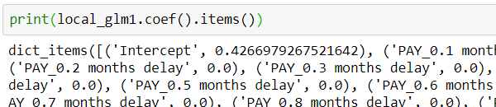


Train penalized linear model in local region
H2OGeneralizedLinearEstimator
Get Local Positive GML Coefficients
R-squared measures

Slide 12
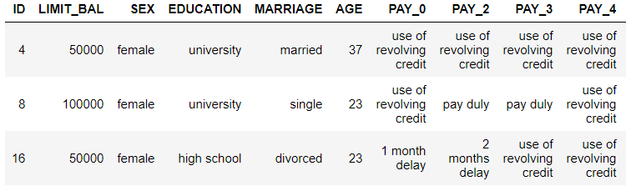
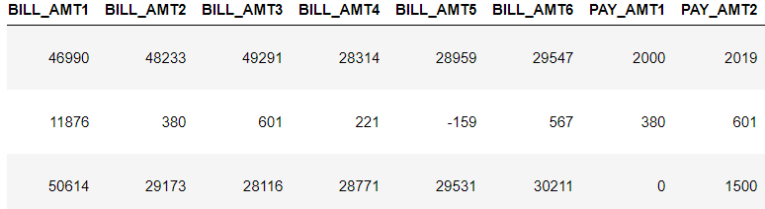
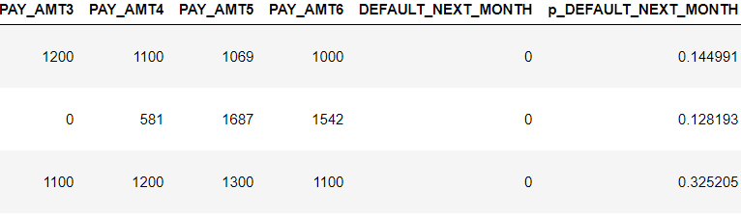
4. Generate reason codes with LIME based on a perturbed sample
Display the reason codes:
5. Use LIME to generate descriptions for a local region with a practical sample.
Create a local region based on SEX and merge with GBM model predictions
All female sample

Slide 13

Train penalized linear model in local region
H2OGeneralizedLinearEstimator
R-squared measures

Slide 14
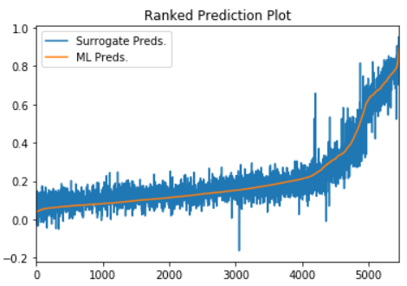
6. Generate a ranked predictions plot to assess validity of local explanatory model.
7. Generate reason codes using a practical sample
Create explanations ('reason codes') for a row in the local set:

Slide 15
Resource
X: Variables
y: prediction target
Encode
Parsed
Dataset
model
Test
Dataset
H2OGBM
model
Train
Train
Dataset
generate_local_sample
Pick
perturbed_sample
Riskiest User
Perturbed
Sample
encode categorical
Scale, Encode
as_data_frame
row_dummies
scaled_perturbed_sample
Categorical
Riskiest User
Scaled & Encoded Perturbed Sample
H2OFrame
H2OFrame
Distance
Perturbed
Sample
H2OFrame
combine
Perturbed Sample +
Distance
predict
Preds1: (predict, p0, p1)
Pred1 Dataset
Drop predict, p0
Pred1 Dataset
combine
local_glm1
H2OGeneralizedLinearEstimator
Perturbed
Sample
Train
H2OFrame
Relationship:
Generate
X: Variables
y: Prediction
Reason
Code
Coefficient
R-Square

Slide 16
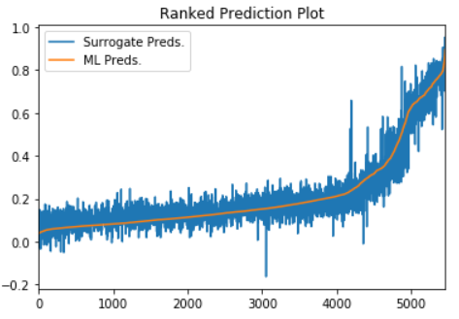
Resource
Parsed
Dataset
H2OGBM
model
Train
Train
Dataset
Test
Dataset
Predict
Pick
Riskiest User
Predicted
Dataset
encode categorical
Drop 'predict','p0'
row_dummies
Predicted
Dataset
Categorical
Riskiest User
H2OFrame
combine
Predicted Dataset+
p1
practical_sample
local_glm2
Filter & keep ‘female’
H2OGeneralizedLinearEstimator
Predicted
Dataset
Train
practical_sample
Relationship:
combine
X: Variables
y: Prediction
Predict dataset
Coefficient
R-Square
Generate
Predicted
Dataset
practical_sample
Reason
Code
Keep 'predict‘ Target
Predicted
Dataset
practical_sample

